Slide 1

Coffee Shop Sales Analysis
Excel Project
Lohitha Mada

Slide 2

Project Overview
Maven Roasters operates across three locations in NYC.
Transactional data from Jan to June 2023 was collected to assess purchase behaviors and enhance operational efficiency.
Goal: Create a dashboard to visually represent key business insights for informed decision-making.

Slide 3
Project Goals
Analyze Sales Trends: Understand how Maven Roasters sales have evolved over the first half of 2023, identifying patterns in revenue growth or decline.
Identify Busiest Days: Determine which days of the week have the highest foot traffic and sales, and explore the reasons behind these trends to improve operational efficiency.
Evaluate Product Performance: Analyze which products are most and least frequently purchased, and identify the key products driving the most revenue for the business.
Provide Data-Driven Recommendations: Use the insights to suggest actionable strategies for increasing sales, improving customer satisfaction, and optimizing store operations.

Slide 4
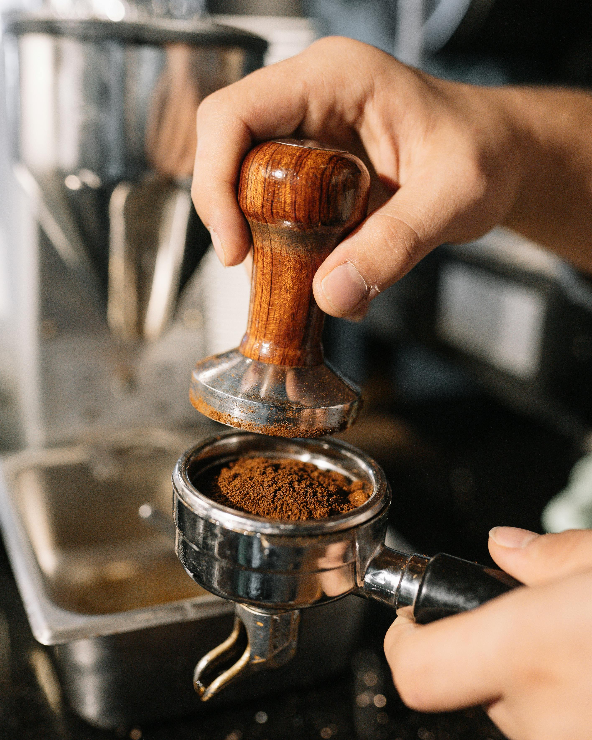
Approach to Data Insights
Dataset Size: 149,116 records, 11 fields.
Exploration: Used filters to explore and analyze data integrity.
Data Integrity: Trimmed unwanted spaces, no unwanted data or duplicates found.
Revenue Calculation: A new column was added to compute revenue.
MONTH,WEEKDAY and HOUR functions used to create new columns for Month and Day of the Week (formatted as text with TEXT function).

Slide 5

Approach to Data Insights
Product-Level Trends: Analyzed using PivotTables.
Data Summaries: Monthly Revenue, Transactions by Day of the Week, Hour, and Product Category summarized in descending order.
Top 15 Products: Sorted by transaction count and revenue.
Dashboard Creation: Included all charts, KPIs for Monthly Revenue, Transaction Count, and Average Revenue. A slicer was added to track trends across all charts.

Slide 6
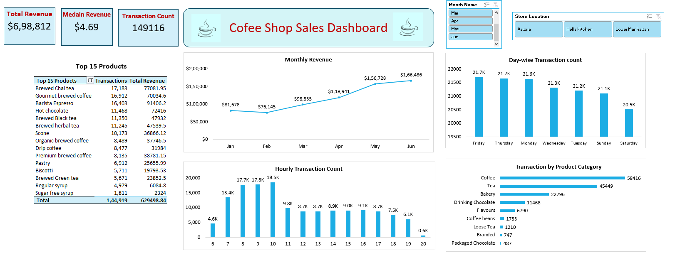

DASHBOARD

Slide 7

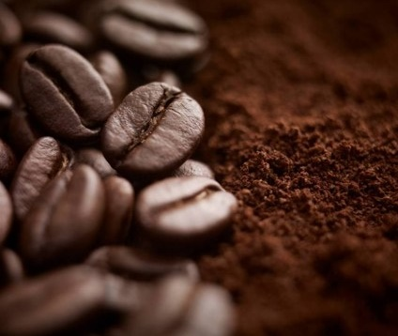

Revenue Analysis
KEY INSIGHTS
Product sales Analysis
The best-performing store in terms of revenue, generation is Hell’s Kitchen with $236,511, outperforming the other two locations.
Peak Sales Times: At Hell's Kitchen, the highest number of transactions occurs on Fridays and Thursdays between 8 AM and 10 AM.
Top Product: Barista Espresso is the most sold product category during this time, with coffee being the top-selling item.
Barista Espresso is the top sold product category with $91,406 followed by Brewed Chai Tea and Hot Chocolate.
Coffee and tea are the top-selling items, followed by bakery products.
Organic beans and premium beans are the least sold product category. Packaged chocolate is the least sold item.
Day – Wise Analysis
Highest Foot Traffic: Friday and Thursday have the highest foot traffic sales between 8 to 10 AM.
Median Foot Traffic: Monday and Wednesday generate the median sales transactions.
Lowest Revenue Days: Saturday generates the least revenue, with Sunday following closely behind.

Slide 8
Recommendation
Optimize Staffing During Peak Hours: Given the rush between 8 AM and 10 AM, ensure that staffing is optimized to reduce wait times and improve customer service during these critical hours.
Customer Feedback Integration: Regularly collect and analyze customer feedback to refine offerings and improve service quality, ensuring customer preferences are met.
Weekend Specials: Since weekends (especially Saturdays) show lower sales, consider introducing exclusive weekend offerings like brunch specials, limited-time menu items, or family-focused promotions to drive traffic.
Collaborations and Events: Partner with local businesses for cross-promotions or host in-store events to increase foot traffic and attract new customers.

Slide 9
Thank You
Lohitha Mada

